Slide 1
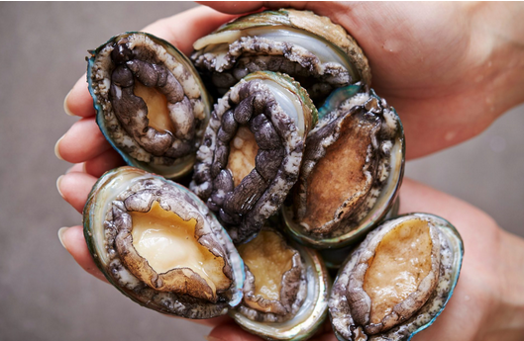
Data Analysis, Prediction and Classification using Machine Learning Algorithms to Identify Abalone Gender
Carl Jeong -
M.Eng – Mechatronics Engineering
Student number: 501191102
Course: Computer Engineering Topics – Machine Learnning

Slide 2
Problems Faced in Marine Farming
Abalones are a shelled species that can be confusing when determining gender. Maintaining a balanced sex ratio and equalizing a 50 – 50 rate as best as possible is important for effective reproduction and protecting the ecosystem. Environmental changes can also affect abalones as well
Implications for Proper Breeding
- Proper Pairing can lead to healthy functioning species and ensure the species does not risk endangered or extinction
Reasons for Determining
By sorting, selecting positive traits works for reproduction
Contributes to ecosystem functionality, marine life improvement, and determining how to sustain population numbers.

Slide 3
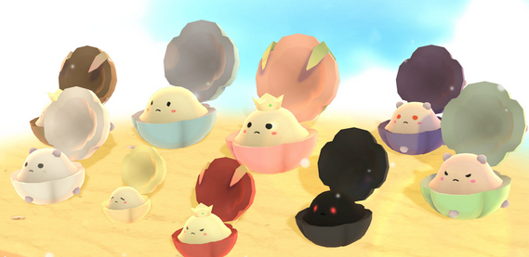
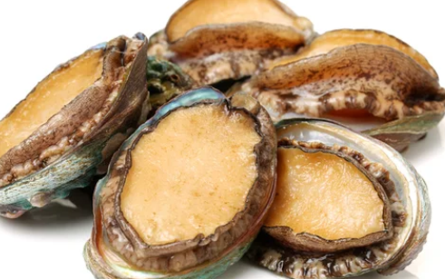
Main Agenda
The Goal of this research project is to create a neural network or machine learning algorithm that can classify Male, Female, and Infant based on the features given what specific features each one has.

Slide 4
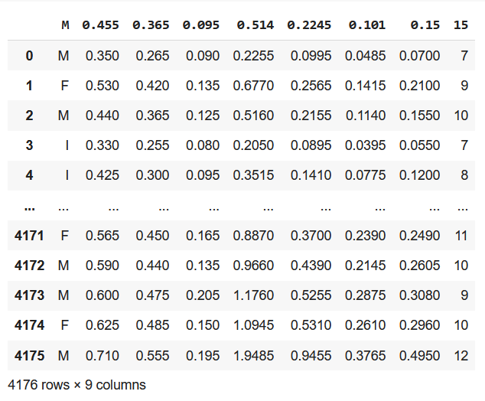
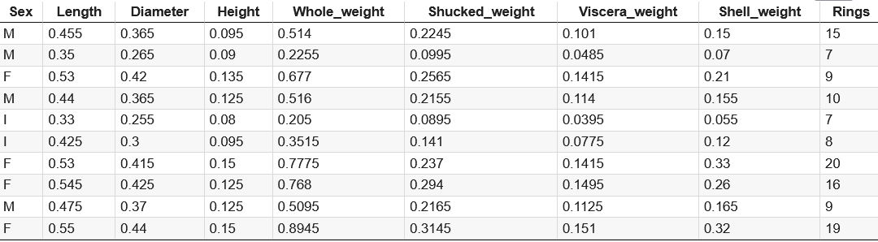
Abalone Dataset
Abalone.data now is output into data.csv
Abalone.data
This shows the 4177 data points for demonstration and collection of data
Data.csv, the CSV file is made to determine characteristics, making this easier to extrapolate and use for the prediction based analysis/project

Slide 5
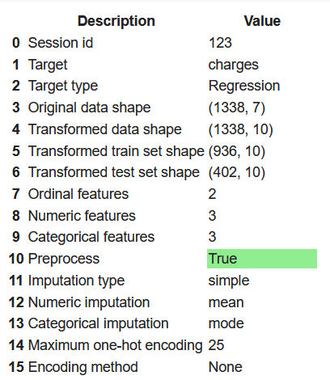
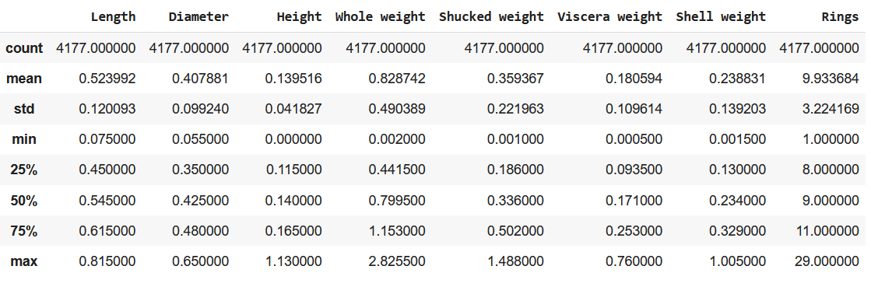
PyCaret 3.2.0 Advantages
Scipy and numpy mathematical formulae
Pipeline Process and uses
Session ID in order to create models
Compare Models, Analyze models
Numerical analysis from
Classification and Regression

Slide 6
Characteristics of Abalone Gender
Female | 1307
Infant | 1342
Male | 1528
Univirate Analysis shows:
Infant did appear to match with other categories
2nd quartile/median shohws a lot of similarties between the genders. Rings : 1-30, Everything Else: 0-2
Infants are better analyzed, then Female, then least, Male

Slide 7
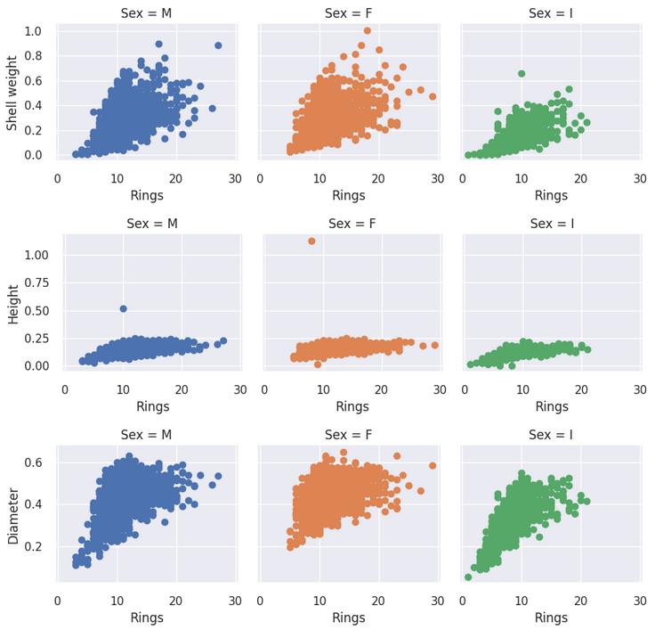
Male vs Female vs Infant Data
There are more Males than Females and Infants
SMOTE (Synthetic Minority Oversampling Technique) can be used to average out and control the sample.
Females have a lot of
Scattered data for shell
Weight and diameter
Males despite having a lot
Of data, are harder to
analyze

Slide 8
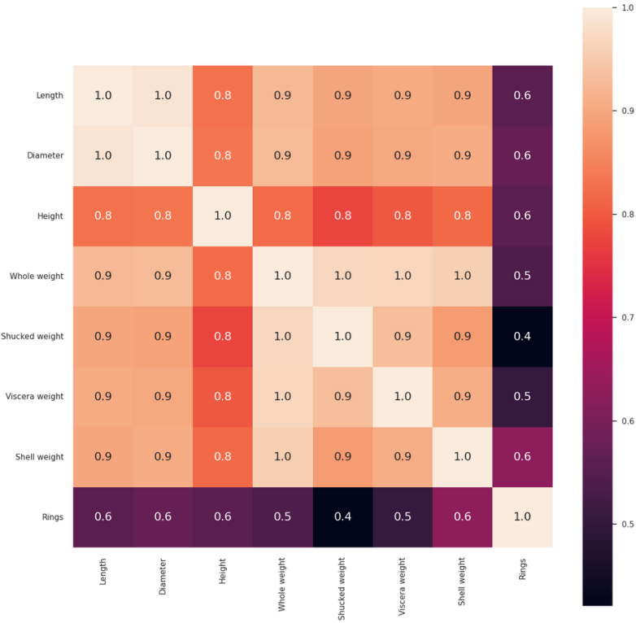
Correlation Matrix
Weaker Correlation
Is closer to 0.
Stronger Correlation
Is closer to 1.
Rings aren’t useful but can help as an outlier,.
Height, Length, and Diameter make better categories.

Slide 9
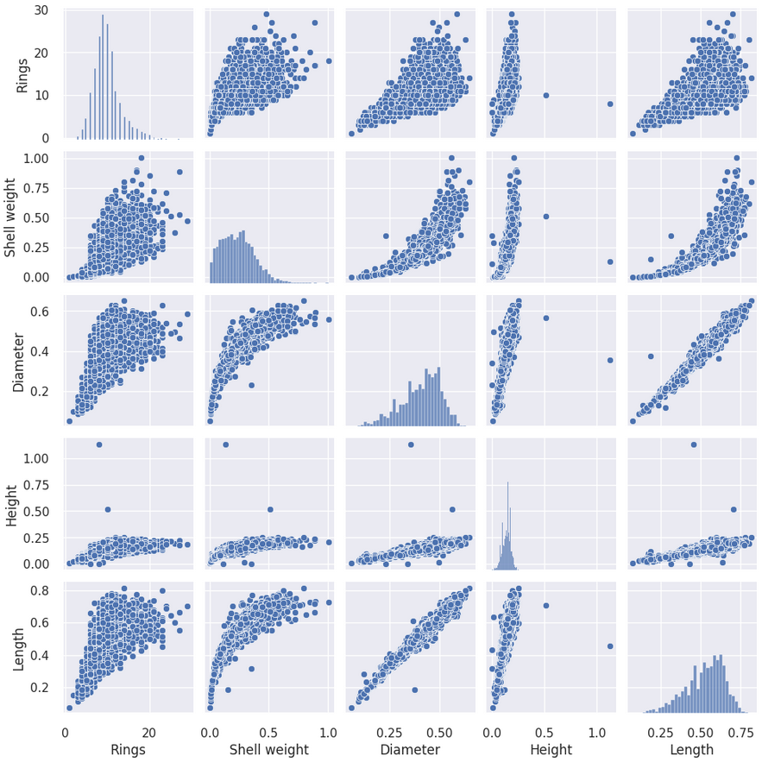
Seaborn Pairplot of Features
Similar plots are all bar graphs based on histograms, but rings and length are very separated, Height is more closer as a stronger correlation
Scattered plots are polynomial, diameter and length comparison are very linear oddly enough.

Slide 10
Pre-Processing
A) Normalization
Mainly will use Min-Max Analysis, this will adjust for a range of lower numerical value to the higher value.
Z-score Mean is also a good alternative for Normalization
B) Class Handling Methods
Keep in mind, there are more Males compared to Females and Infants.
Taking averages and means between three categories works

Slide 11
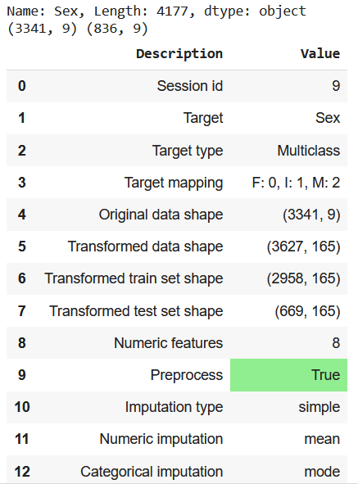
Feature Engineering
Using Pycaret, we can compare models and decide which ones we can use. There are complex connections in the features so when combining them, we need to use
Classification Methods are
done repeatedly
Degree of Polynomial
= 2, 3, or 4 is a good place

Slide 12

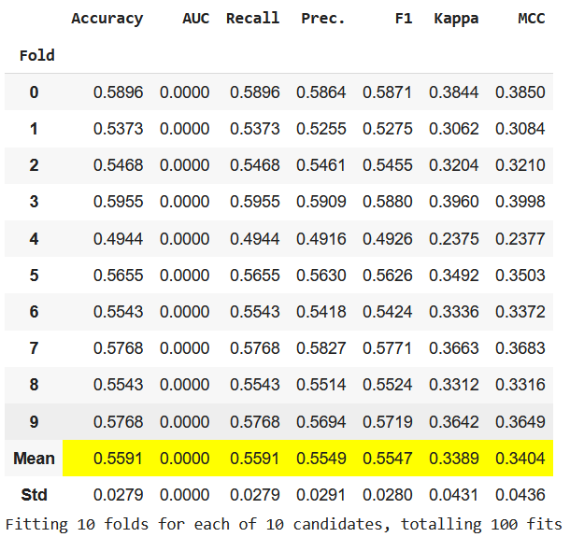
Training and Testing Setup
Machine Learning Model Evaluation:
70% Train 15% Validation/15% Tests
80% Train 10% Validation/10% Tests
Best-fold (10-fold) is done to finalize and work on model
Blend (10-fold) and Tuned (10-fold) worked really well as a result here

Slide 13
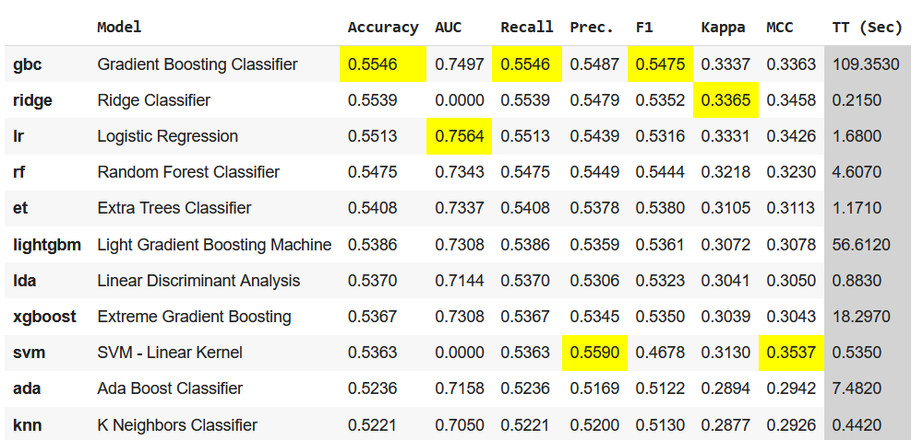
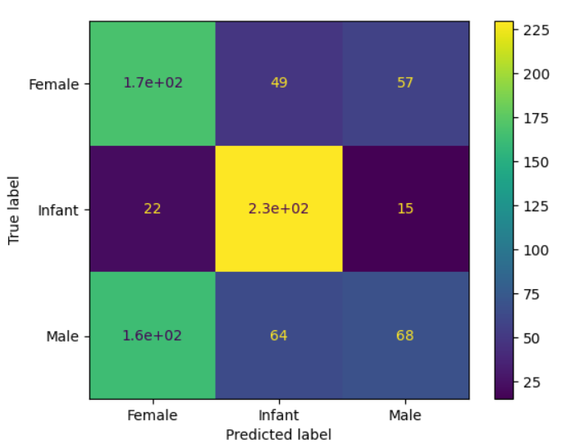
Model Results
Blend Model – (10 fold)
Gradient Booster works best
for Accuracy, F1, and Recall
SVMs are best for Precision
At 57%
KNN didn’t work as planned
Logistic Regression has best AUC
Confusion Matrix
Infant and Female have highest, but Males have some errors required

Slide 14
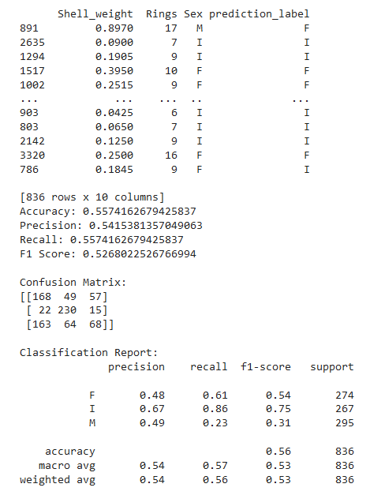
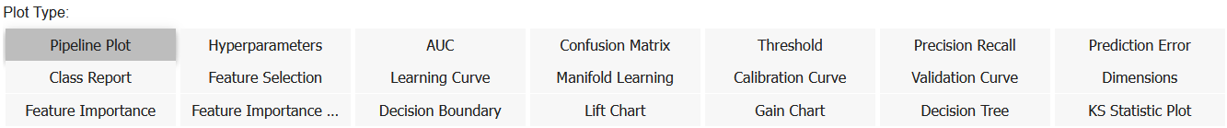
Evaluation Model of the Project
Results = Very low,
Some refining and delicate touches are required. As seen in Accuracy, Recall, F1,
Models that worked: Blended and Tuned
Infants and Females may better chances of getting classified, but Males are very low, the model requires some fine tuning.

Slide 15
Limiting Factor and Limitations
The AI has limitations, misidentifying is common, and complete elimination of mistakes is impossible, however the main goal is minimizing error to make a tolerable/negligible error.
The model takes use of all features in order to give a prediction. But What if one of the features is not available?
Example: Correlation shows Height is very high

Slide 16
Conclusion
Possible Future Endeavors:
Improve model by noting geographical location of abalones
Differing depths of water and see if abalones change characteristics
Correlation Features and error corrections to make model better in precision, F1, Recall, and accuracy
Needs more data and work with experts in marine biology and zoology for better understanding of the topic.

